Slide 1
Style Guide
[THE WEEKND WEBSITE]
MAINAK C

Slide 2
About the project :
I'm an avid fan of The Weeknd music, and I noticed that his website might be smoother. I wanted to take on the task of improving the user experience for his fans I was looking through several music artist websites when I came across The Weeknd. I believed that some design components could be improved, and I wanted to demonstrate my abilities by designing a more visually appealing and user-friendly website. I've seen that The Weeknd has a sizable fan base, and his website serves as a crucial venue for his fans to interact with his music and content. I wanted to help by developing a more interesting and interactive website that would better showcase his work.

Slide 3
Urgency and relevance of that project and its applicability :
Upgrading the user experience: By upgrading the design, navigation, and functionality of The Weeknd's website, fans will be able to access and engage with his music, videos, and other content more easily. A revamped website might potentially improve fan engagement and revenue through item sales, concert tickets, or other revenue streams by offering fans with a better user experience and more opportunities to engage with The Weeknd content.
A website makeover may be especially vital for an artist like The Weeknd, who has a vast and loyal fan base, in terms of urgency and relevancy. A website that stands out and efficiently promotes an artist's brand might be critical for success in a highly competitive music market. A website redesign can also help an artist keep up with shifting trends and technologies, as well as better engage with followers in a quickly changing digital landscape.

Slide 4
Colors : Palettes
Primary
Secondary
The primary palette should take up a minimum of 50% of the color of the design. The secondary palette should be around 35% and the neutral palette no more than 15%.
[Dark & Light shade of gray]
HEX: [#303030 #F2F2F2]
Tertiary
[White]
HEX: [#FFFFFF]
[Red & White]
HEX: [#FF0000 #FFFFFF]

Slide 5
Typography :
Primary Headline Font
[font-family: ‘Raleway’, sans-serif;]
Primary Text Font
[Font Family: ‘Noticia Text’,serif]
Styles outlined are suggestions for hierarchy and should be the starting point for all creative styling. Individual type sizes and leading will vary based on application.
HEADLINE ONE
HEADLINE TWO
HEADLINE THREE

Slide 6
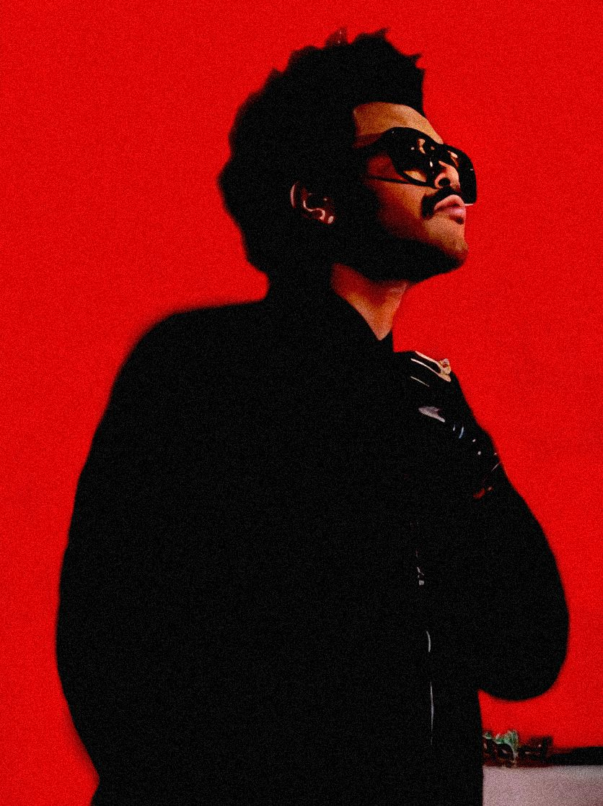
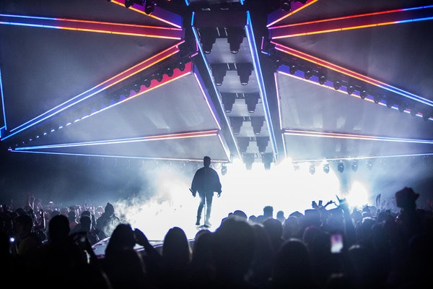
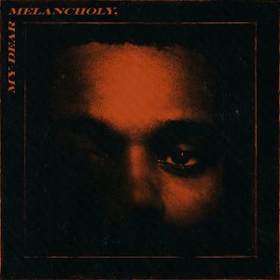
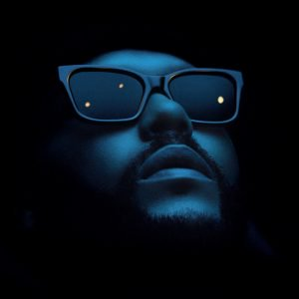
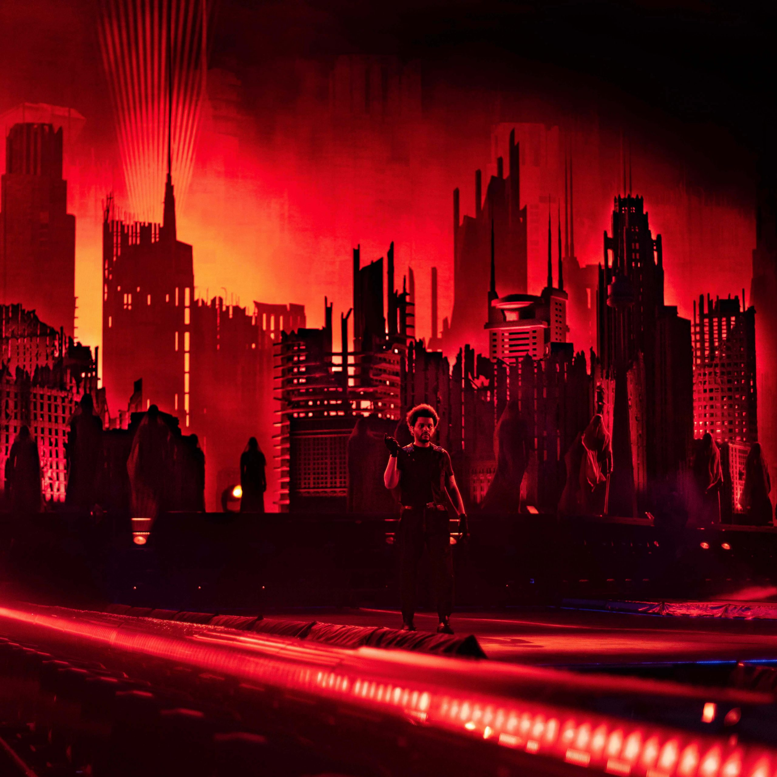
Photography : Tone & Feel
Photography plays a big role in setting the tone of the brand, reinforcing the brand attributes and messaging, as well as complementing the design elements.

Slide 7
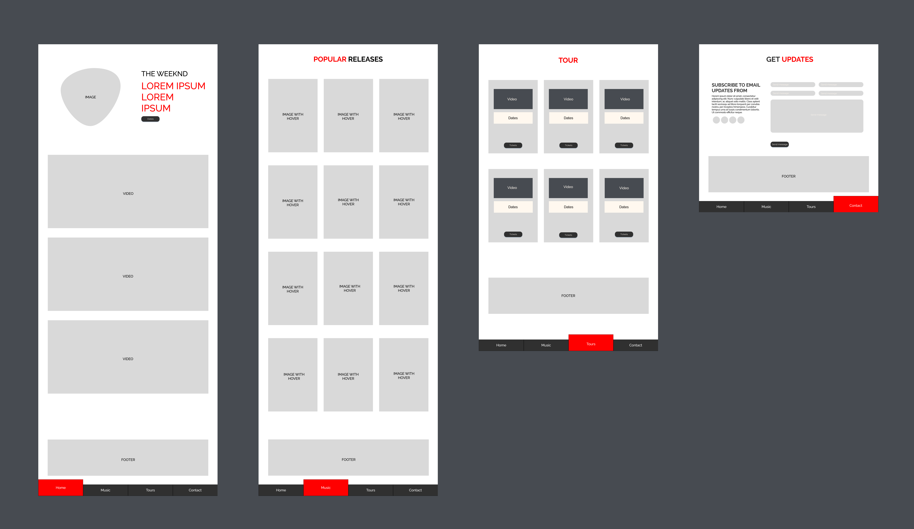
Blueprint

